Slide 1
LIST 35

Slide 2
Day 1

Slide 3
Mis/Mit
Latin Root: To send

Slide 4
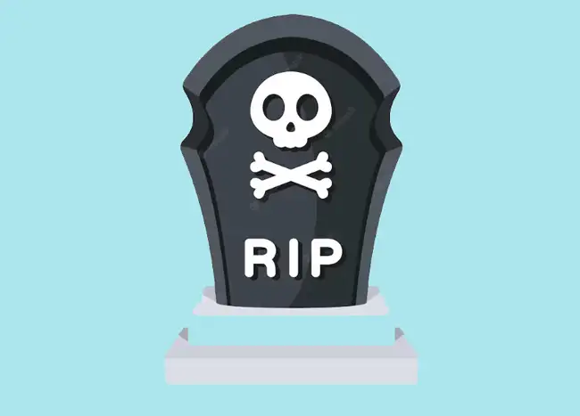
Demise (n)death or end-a permanent “sending away” or putting away
Talking Tidbit:
What do you think will happen if there was a demise in social media?

Slide 5
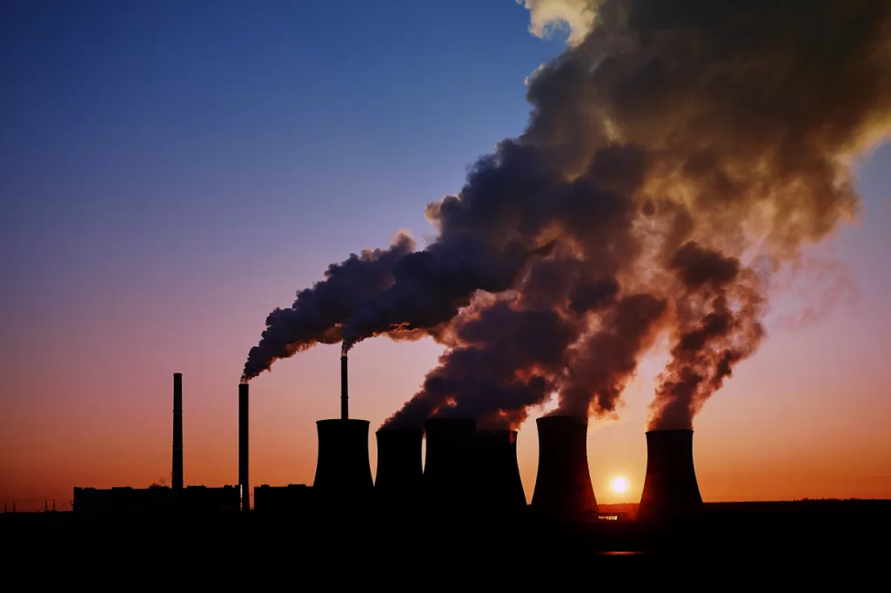
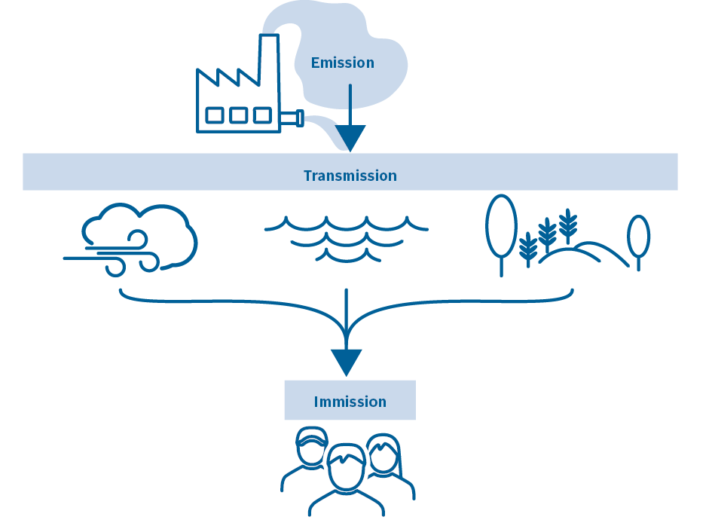
Emission (n) something sent out or given off
Talking Tidbit:
What types of emissions might come from an object or appliance in your home?

Slide 6
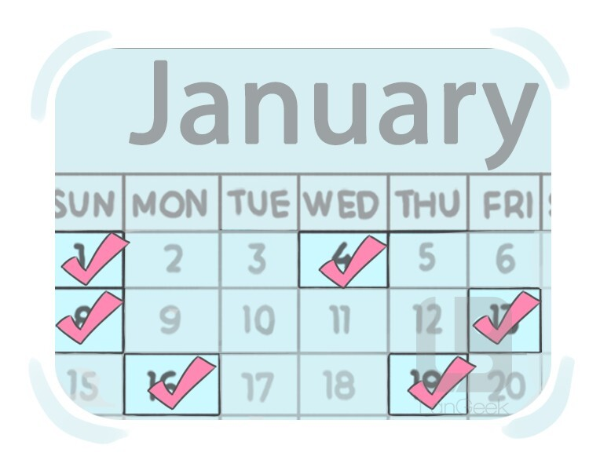

Intermittent(adj) being sent, but stopping or pausing at intervals
Talking Tidbit:
What kinds of things happen in an intermittent way?

Slide 7


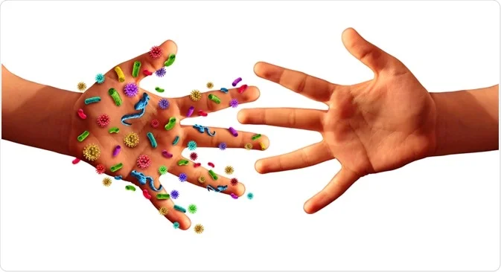
Transmit (v) to send across or pass something along
Talking Tidbit:
What are some things you can transmit?

Slide 8
ology/logist
Greek Suffix: “The study of” or “one who studies”

Slide 9
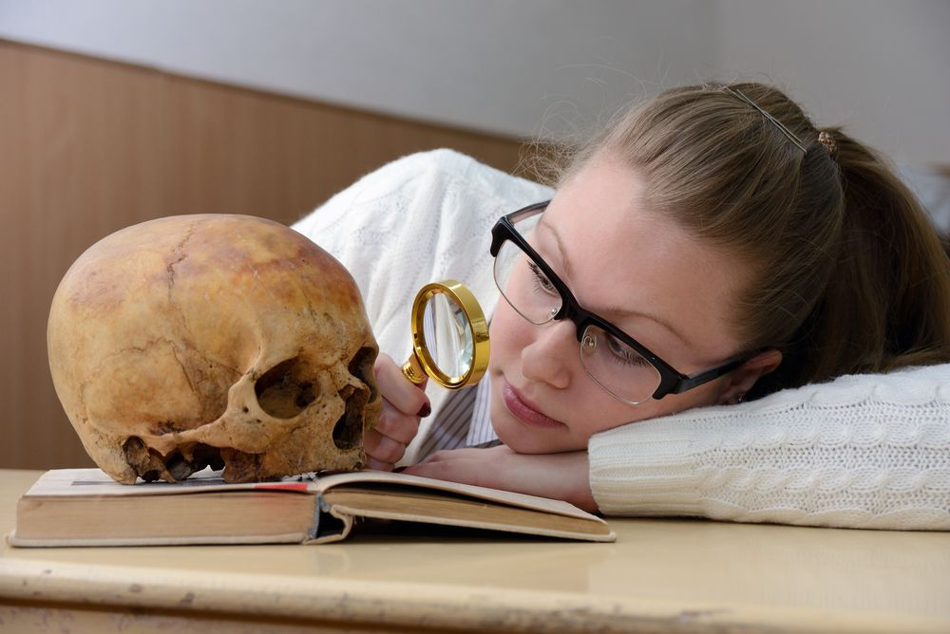
Anthropology(n) the study of human beings, especially their fossil remains, characteristics, culture, customs, and beliefs
Talking Tidbit
What part of anthropology do you think you’d like to study? Why?

Slide 10
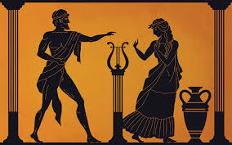
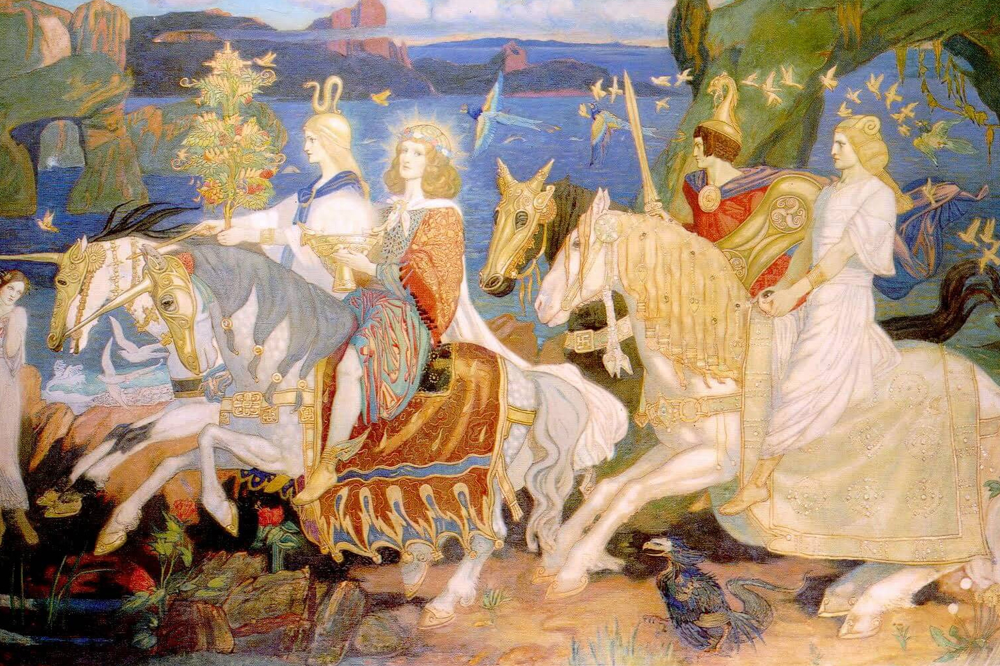
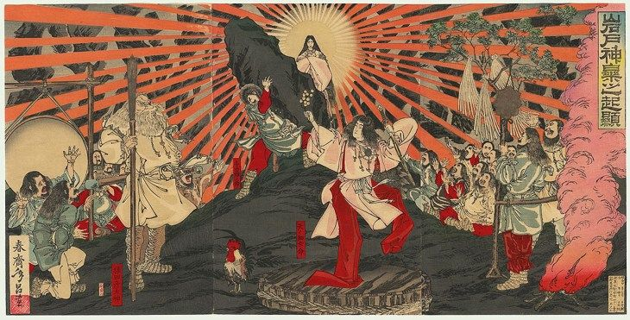
Mythology (n) the study of myths, traditional stories about a particular country or person
Talking Tidbit
Why might people study mythology?
Greek Mythology
Celtic Mythology
Japanese Mythology

Slide 11

Pathology (n) the study of the causes and nature of diseases
Talking Tidbit
Why is it important for people to study pathology?

Slide 12

Technology (n) the study and use of scientific knowledge to solve problems and control physical objects and forces
Talking Tidbit
Name things that you use everyday that are the result of technology

Slide 13
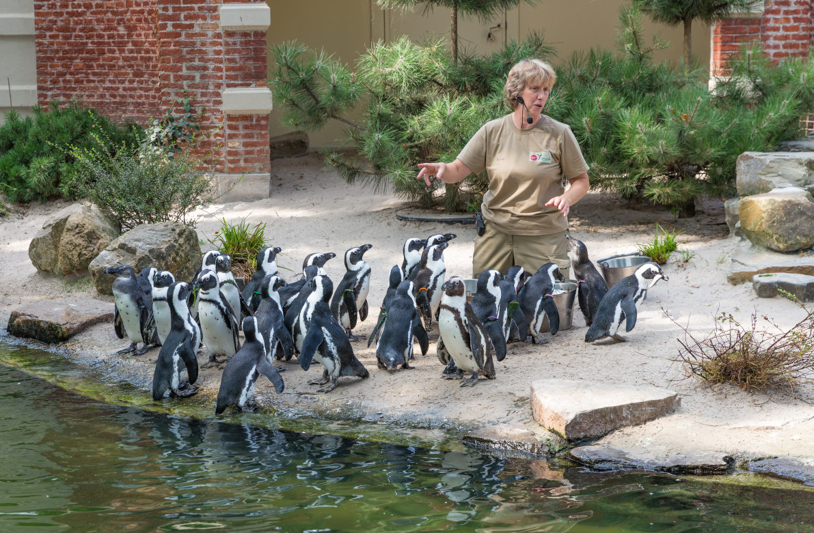

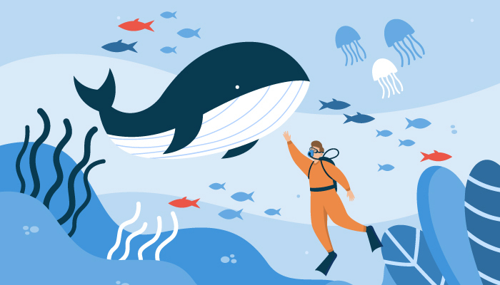
Biologist (n) an expert in the scientific study of living organisms
Talking Tidbit
Why is it important for a biologist to study the behavior of a species?

Slide 14
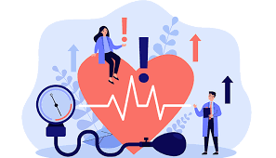
Cardiologist (n) a medical expert who studies the heart
Talking Tidbit
What is the difference between a cardiologist and a biologist?

Slide 15
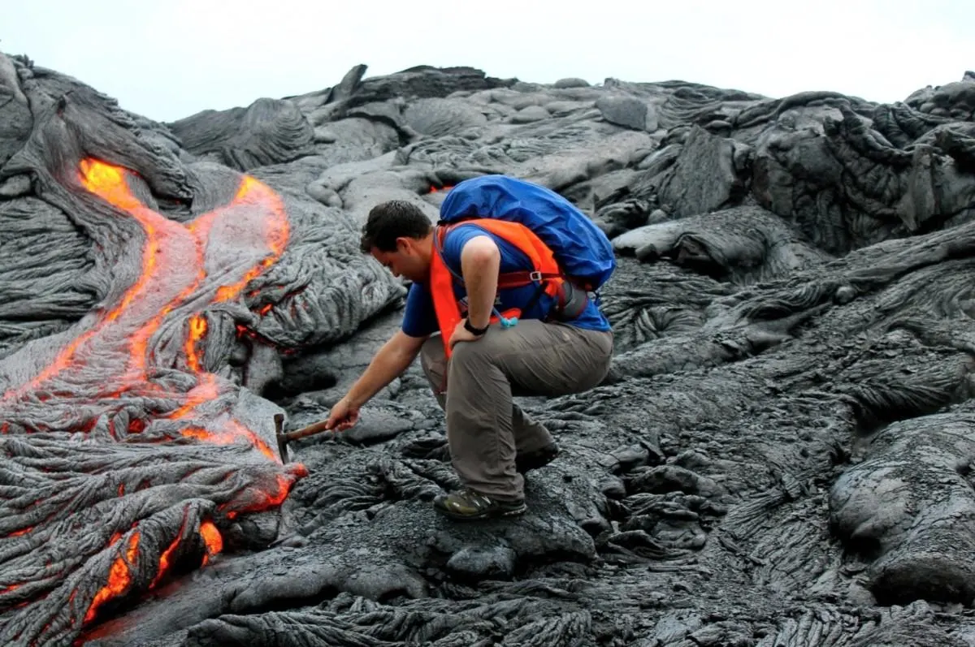
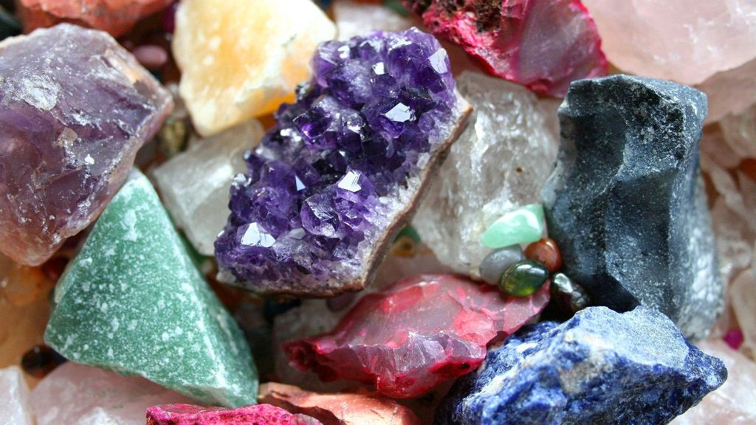
Geologist(n) an expert in the physical history of the Earth and how it changes
Talking Tidbit
What would be the most interesting thing about being a geologist?

Slide 16

Psychologist(n) an expert in the study of the mind
Talking Tidbit
What kind of training might a psychologist need before working in a clinic

Slide 17
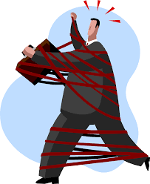
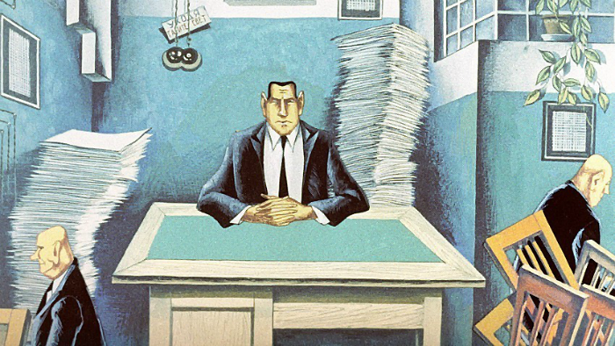
Review: bureaucrat(n)- (n) a government official who insists that people follow rigid rules
Talking Tidbit
Do you think it is an insult to be called a bureaucrat? Why or why not?
In a bureaucratic system, which is characterized by strict rules and hierarchical structures, "red tape" represents the cumbersome administrative processes that can hinder quick decision-making and action.

Slide 18
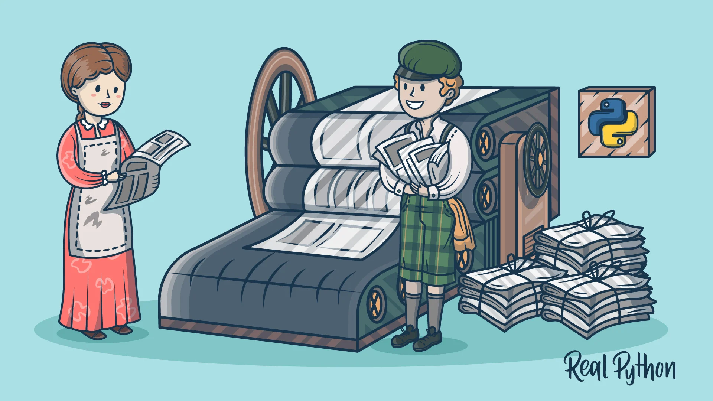

Review: Publication (n) the printing and selling of books, newspapers, and magazines
Talking Tidbit
What are some different types of publications you encounter in your daily life?

Slide 19
DAY 3

Slide 20
CHECK YOUR PRACTICE SPELLING TEST:
8. pathology
9. mythology
10. geologist
11. psychologist
12. biologist
13. publication- review
14. beaurocrat- review
demise
cardiologist
technology
intermittent
transmit
anthropology
emission

Slide 21
DAY 4

Slide 22
CHECK YOUR PRACTICE SPELLING & Definition TEST:
psychologist
geologist
pathology
mythology
transmit
intermittent
biologist
8. cardiologist
9. demise
10. emission
11. anthropology
12. technology
13. bureaucrat - review
14. publication-review

