Slide 1
5th Grade Word Study: Cycle 8
Notes:
Note that this is a 4-day week.

Slide 2
Day
1

Slide 3

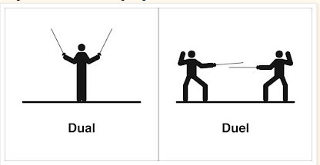
HOMOPHONE PAIR!

Slide 4
What do you notice about this list of words?
erupt | interrupt | rupture
abrupt | disrupt | promote
motion | demote | locomotive
motivate | emotion

Slide 5
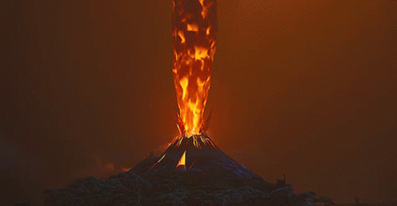

erupt
(v) To burst out suddenly or explode violently
Talking Tidbit:
Describe a time when you erupted with joy.
The volcano began to erupt, spewing lava and ash into the sky.

Slide 6

interrupt
(v) To stop or break in on an action or conversation
Why is it important to avoid interrupting someone when they are speaking?
Please do not interrupt your classmates while they are sharing their ideas.

Slide 7
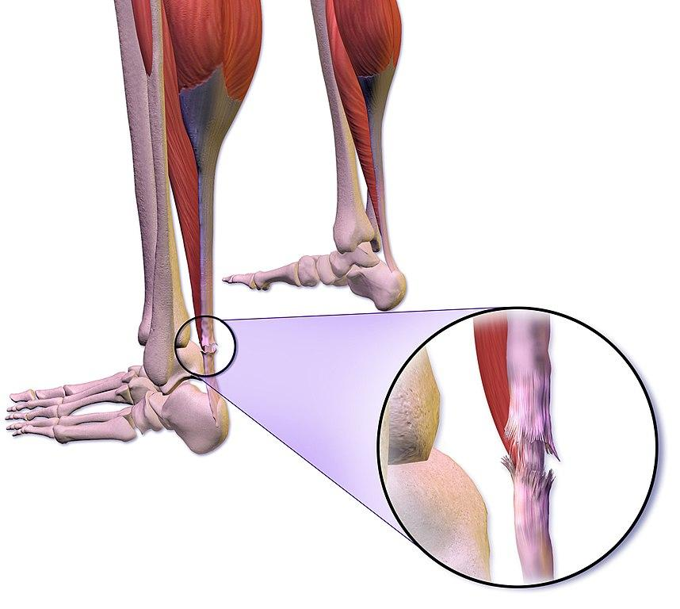
rupture
(v) to break or burst suddenly; (n) a break or tear
What might happen if a water pipe under the street were to rupture?
rupture
The rupture in the tire caused it to lose air.

Slide 8

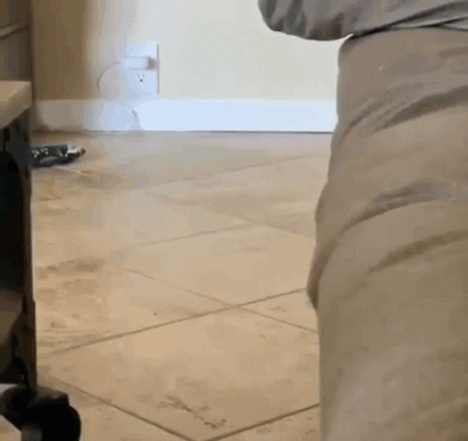
abrupt
Describe a time when an abrupt change surprised you. How did you handle it?
(adj) sudden or unexpected
The weather took an abrupt turn, and suddenly it started to snow.

Slide 9
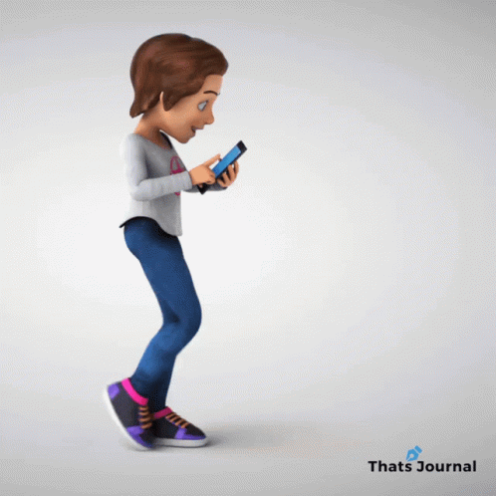
disrupt
(v) To interrupt a process or normal order of something
Talking Tidbit
How has social media disrupted the way people spend their time?
What are some ways that construction work can disrupt daily life in a neighborhood?

Slide 10


promote
(v) To support or actively encourage a cause or process; to move to a higher ranking position at work
Our teacher wants to promote teamwork by encouraging group projects.
How can we promote kindness and respect in our classroom?

Slide 11

motion
(n) The action or process of moving or being moved
The motion of the pendulum is steady and predictable.
Talking Tidbit
What are some examples of motion you see every day?

Slide 12

demote
(v) To reduce to a lower rank or less senior position
After the missing too much work, the manager decided to demote the employee to a lower position.
Talking Tidbit
What might cause a professional baseball player to be demoted to the bench?

Slide 13
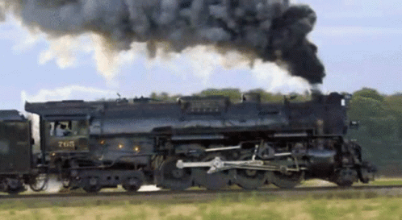
locomotive
(n) A vehicle that runs on rails and is used for moving railroad cars
The locomotive pulled the train cars across the country.
Talking Tidbit
Based on the picture, how might a locomotive contribute to climate change?

Slide 14

motivate
(v) to encourage
The coach's encouraging words helped to motivate the team to win the game.
Talking Tidbit
What are some ways that teachers and parents can motivate students to do their best in school?

Slide 15



emotion
(n) The way a person’s mood is shown
She felt a wave of emotion as she watched the sad movie.
Talking Tidbit
Why is it important to understand and express our emotions in a healthy way?

Slide 16


GRAMMAR GOAL FOR THE WEEK:
Correctly write irregular past tense verbs.

Slide 17
Day
2

Slide 18
Change from Present to Past Tense
Past Tense | Present Tense
1. | look
2. | watch
3. | play
4. | bring
looked
watched
played
x
bringed?
brought

Slide 19
Past Tense | Present Tense
1. | speak
2. | take
3. | meet
4. | feel
5. | bring
6. | break
7. | run
8. | see
9. | write
10. | think
spoke
took
met
felt
brought
broke
ran
saw
wrote
thought

Slide 20
Day
3

Slide 21
erupt: ē - rŭpt
interrupt: ĭn - ter - rŭpt
rupture: rŭp - tūre
abrupt: ā - brŭpt
disrupt: dĭs - rŭpt
promote: prō - mōte
motion: mō - tion
demote: dē - mōte
locomotive: lō - cō - mō - tīve
motivate: mō - tĭv - āte
emotion: ē - mō - tion

Slide 22
Day
4

Slide 23
GRAMMAR GOAL FOR THE WEEK:
Correctly write irregular past tense verbs.

Slide 24


Example or Non-Example
erupt
to stay quiet and calm

Slide 25
Example or Non-Example
interrupt
waiting your turn to speak

Slide 26
Example or Non-Example
rupture
a popped blister

Slide 27
Example or Non-Example
abrupt
slowly and carefully

Slide 28
Example or Non-Example
disrupt
whispering in a library

Slide 29
Example or Non-Example
promote
advertising about an upcoming event

Slide 30
Example or Non-Example
motion
going forward or backwards

Slide 31
Example or Non-Example
demote
moving down in rank or position

Slide 32
Example or Non-Example
motivate
scaring someone

Slide 33
Day
5

Slide 34
Spelling Practice Quiz
emotion
erupt
motivate
rupture
locomotive
disrupt
abrupt
demote
motion
promote
interrupt

Slide 35
disrupt

Slide 36
emotion

Slide 37
motivate

Slide 38
locomotive

Slide 39
demote

Slide 40
motion

Slide 41
promote

Slide 42
abrubt

Slide 43
rupture

Slide 44
interrupt

Slide 45
erupt

Slide 46
HOMOPHONE PAIR!
The broom served the ____________________ purpose of sweeping my driveway and fending off aggressive dog.
The fencers began their ____________________.
I will not _________________ with my little brother because I know I’ll get in trouble.
I want to invent a ____________ action washing machine that dries AND irons my clothes.
dual
duel
duel
dual

Slide 47
Day
6

Slide 48
Spelling Practice Quiz
locomotive
rupture
emotion
disrupt
promote
motivate
erupt
demote
motion
interrupt
abrupt

Slide 49
HOMOPHONE PAIR!
She challenged her rival to a duel.
2. I use a dual purpose shampoo that washes and conditions at the same time.

Slide 50
Day
7

Slide 51
Spelling Practice Quiz
interrupt
abrupt
motion
demote
erupt
motivate
promote
disrupt
emotion
rupture
locomotive

Slide 52
HOMOPHONE PAIR!
Write a sentence with each homophone: duel/dual.

