Slide 1
Mental Math
Week 16: Simplify to lowest terms
Notes:
This is a chance for students to continue practicing simplifying fractions using divisibility rules and knowledge of common factors.

Slide 2
Day 1

Slide 3
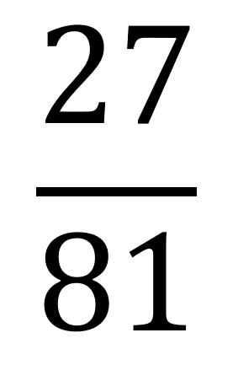
Simplify to lowest terms:
Notes:
Flexible strategies:
Students might notice the common factors of 3 or 9 or 27.
If they divide by 3/3 first, they would get 9/27 and then could divide by 9 to get ⅓.
If they divide by 9/9 first, they would get 3/9 and then could divide by 3/3 to get ⅓.
We can then notice that the highest common factor would have been 27 since we divided by 9 and 3.
This is a good opportunity to review the divisibility rule of 9 - the digits add to a multiple of nine.

Slide 4
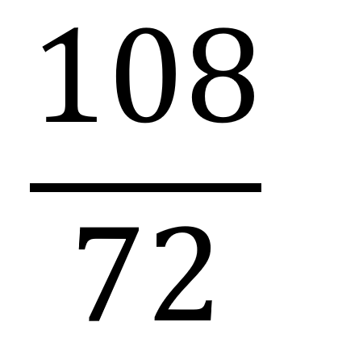
Simplify to lowest terms:
Notes:
Hopefully, students will connect to the previous example with multiple of 9. If they know their facts well, they might immediately see this as 12/8 . They could then divide by 4/4 to get 3/2. They can leave it as 3/2 or see the mixed number 1 ½.
They could also approach this as an FGTO to start and turn into the mixed number 1 36/72. They might notice that 36 is half of 72 or divide by 9/9 and then see 1 4/8 as 1 ½.
Extension question: How could we represent the simplified fraction as a decimal? 1.5

Slide 5
Day 2

Slide 6
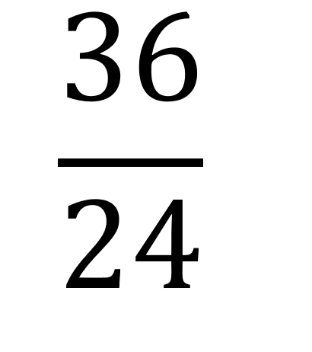
Simplify to lowest terms:
Notes:
Flexible strategies:
Lots of ways to think about this!
Students might start by dividing by 2/2 or 3/3 or 4/4 or 12/12. Notice how you have fewer steps if you find a larger common factor.
Students might also think of this as an FGTO first (1 12/24) which would allow them to quickly see 1 ½.
Extension question: How could we represent the simplified fraction as a decimal? 1.5

Slide 7
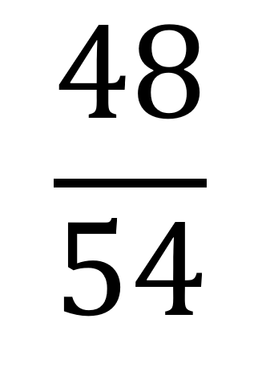
Simplify to lowest terms:
Notes:
Students might notice that both are multiples of 3 using divisibility rules, and get to 16/18 then divide by 2 to get to 8/9.
Students might also notice that both are multiples of 6 if they know their 6s well, and then quickly divide to get 8/9.
Students might also halve to get 24/27 and then divide by 3/3 to get 8/9.
All are great strategies!

