Slide 1
4th Grade Word Study: Cycle 12
Notes:
Note that this is a 4-day week.

Slide 2
Day
1

Slide 3
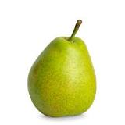


HOMOPHONE PAIR!
very (adj or adv)
vary (v)

Slide 4
What do you notice about this list of words?
dictate | prediction | unpredictable
contradict | dictionary | diction
valedictorian

Slide 5
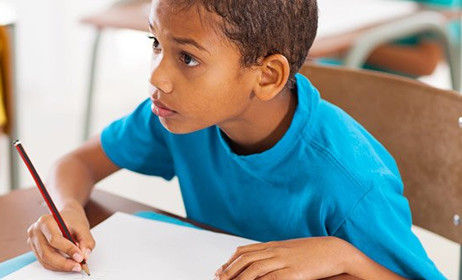
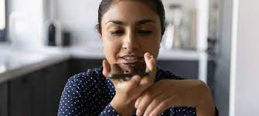
dictate
dict = to say or speak!
(v) to read or say something aloud that a person writes down
Talking Tidbit
Why do some people prefer to dictate text messages instead of typing them?
Teachers dictate words to students for spelling tests.

Slide 6
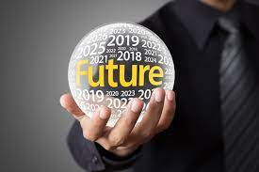
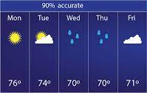
prediction
dict = to say or speak!
(n) a guess about something that will happen in the future
Talking Tidbit
Make a prediction: Will the Celtics win the NBA championship? Yes or no.
My prediction about the ending of the story was completely wrong!

Slide 7
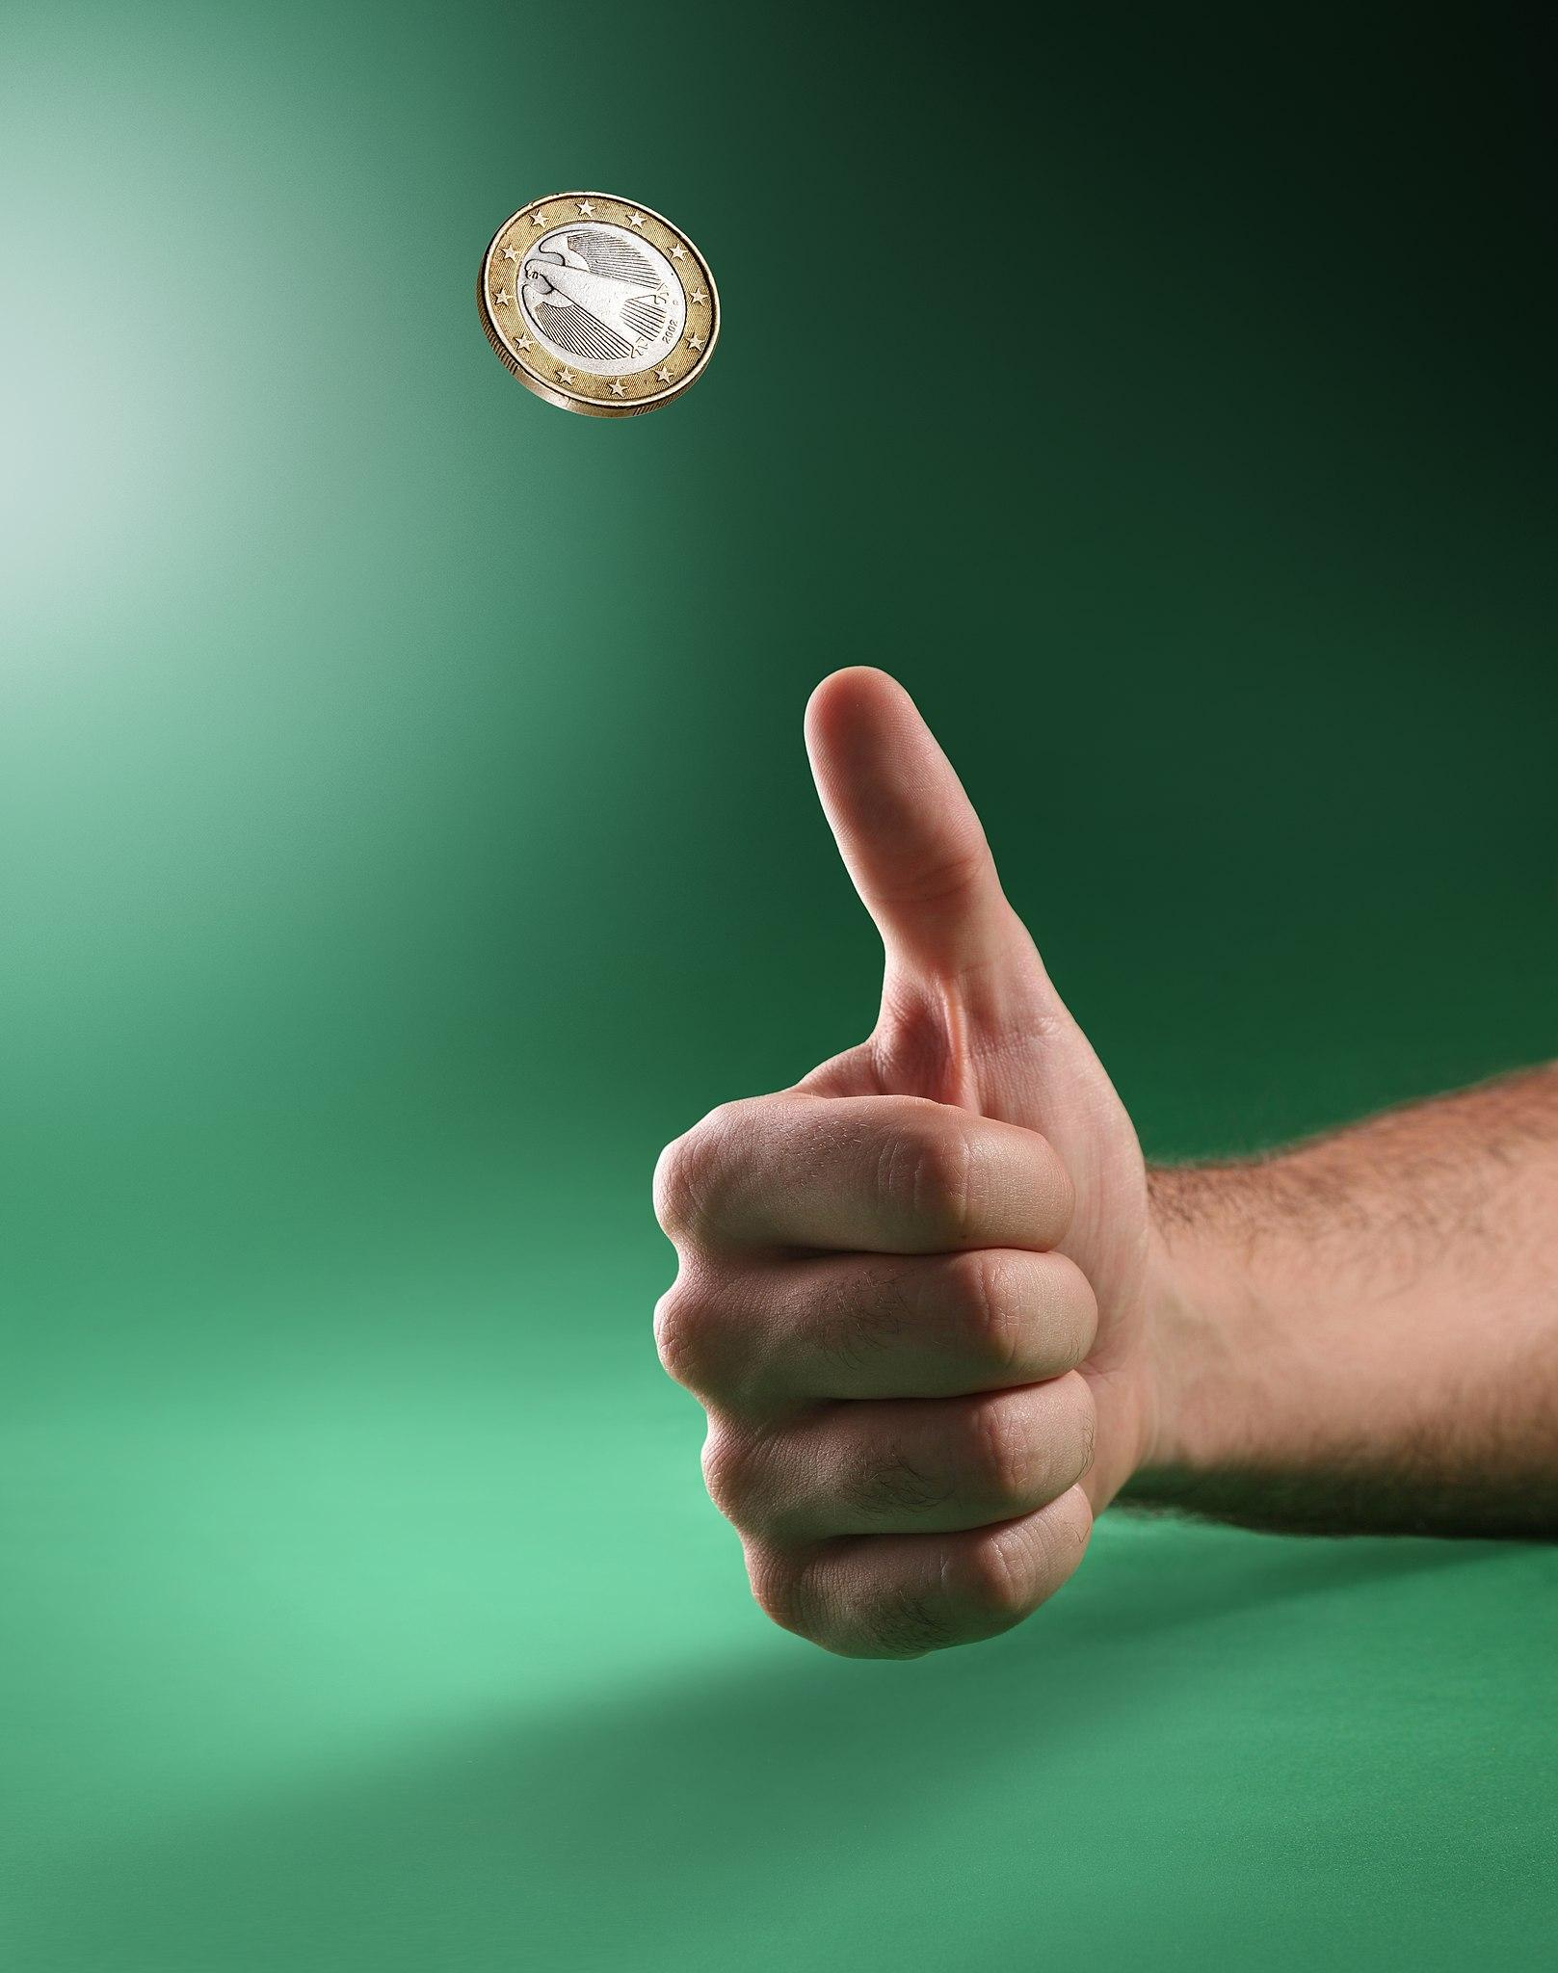
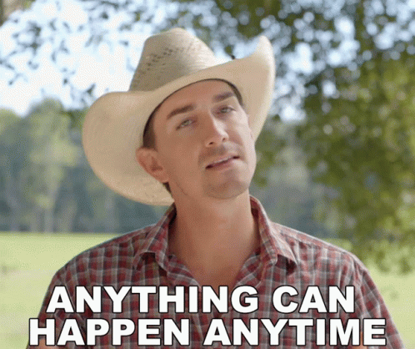
unpredictable
dict = to say or speak!
(adj) not capable of being predicted
Talking Tidbit
What is more unpredictable, the changing seasons or a flip of a coin?
Snow forecasts are unpredictable, and meteorologists are often wrong.

Slide 8
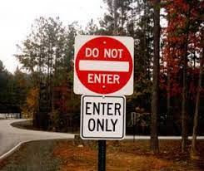
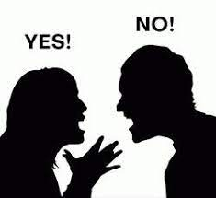
contradict
dict = to say or speak!
(v) to say the opposite of what someone else says
Talking Tidbit
Is it always rude to contradict someone? Why or why not?
During the debate, the Dan contradicted the point made by an earlier speaker by presenting stronger evidence.

Slide 9
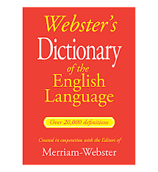
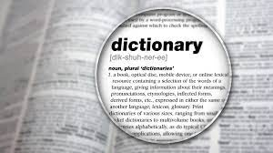
dictionary
dict = to say or speak!
(n) a reference that provides the definition of words
Talking Tidbit
Why is it helpful to keep a dictionary nearby when writing an essay?
You can use a dictionary to find the meaning of an unknown word.

Slide 10
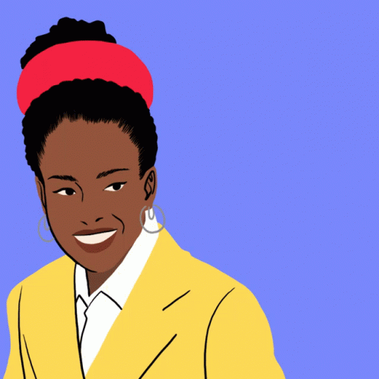
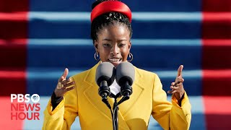
diction
dict = to say or speak!
(n) choice of words
(n) clear and specific pronunciation of words
Talking Tidbit
How does Amanda Gorman display strong diction both in her poem and in her presentation of the poem?
Why is it important to use clear diction during a class discussion?
Langston Hughes used powerful diction to picture strong images in the minds of his readers.

Slide 11
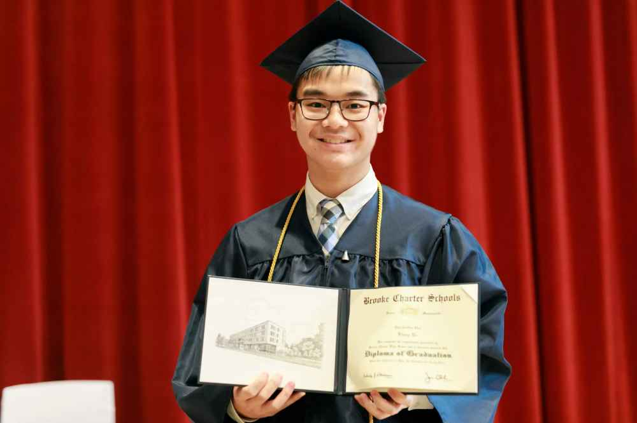
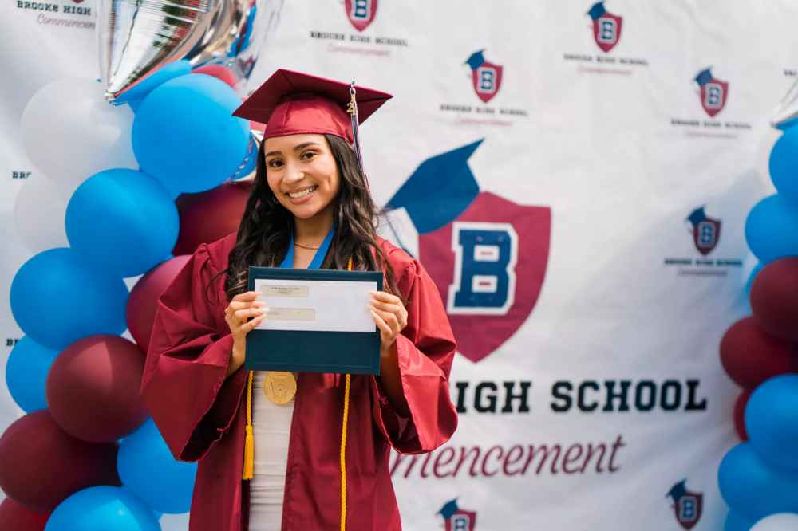
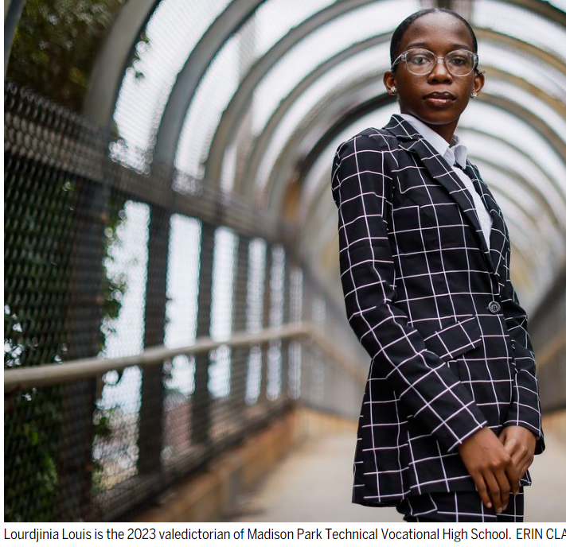
valedictorian
dict = to say or speak!
(n) the student usually having the highest grades in
a graduating class who usually (but not always) delivers a speech at graduation.
Talking Tidbit
What might you need to do to become the valedictorian of your high school?
The valedictorian's list of after school clubs was also impressive.

Slide 12
Day
2

Slide 13
Review! What’s a pronoun? What’s an antecedent?
Bud is the main character in Bud, Not Buddy, and he is hilarious.
A pronoun is a word that replaces a noun in a sentence. Pronouns help avoid repetition and make sentences smoother.
An antecedent is the noun or noun phrase that a pronoun refers to or replaces in a sentence.

Slide 14
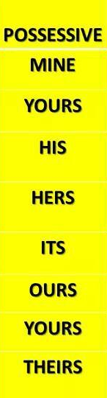
Possessive Pronouns
type of pronoun used to show ownership or possession.
replace possessive nouns to show that something belongs to someone or something, without repeating the same noun.
  For example:
    The book is mine.
    The soccer ball is his.
    The desks are theirs.

Slide 15



Pronouns: This vs. That
Use that for singular objects that are farther away.
Use this for close-by singular objects.
This is a shaded dot.
That is also a shaded dot.

Slide 16
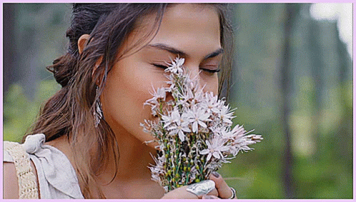
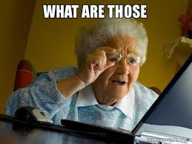
Pronouns:These vs. Those?
Use these for close-by plural objects.
Use those for plural objects that are farther away.
?
These are lovely flowers.

Slide 17
Day
3

Slide 18
Day
4

Slide 19
Pronouns:This vs. That
Use that for singular objects that are farther away.
Use this for close-by singular objects.
This is a shaded dot.
That is also a shaded dot.

Slide 20
Pronouns:These vs. Those
Use those for plural objects that are farther away.
Use these for close-by plural objects.
?
These are lovely flowers.

Slide 21
Adjectives:This/That/These/Those
We can use ‘this’ and ‘these’ to describe people/things that are near us.
· I like this pen.
· I want these pens.
We use ‘that’ and ‘those’ to describe people/things that are far away.
· Do you like that picture on the wall?
· Do you like those pictures on the wall?

Slide 22
Which one?
________book over there is a collector’s item. (this/that/these/those)
________kitten I am holding is very soft! (this/that/these/those)
____________ mittens right here are mine. (this/that/these/those)
__________________ dogs frighten me, so I keep my distance. (this/that/these/those)
That
This
These
Those

Slide 23


Example or Non-Example
valedictorian
someone who sends a letter to their classmates at graduation

Slide 24
Example or Non-Example
diction
the way words are pronounced

Slide 25
Example or Non-Example
unpredictable
the date of your birthday

Slide 26
Example or Non-Example
dictate
speaking to Siri or Alexa

Slide 27
Example or Non-Example
contradict
arguing

Slide 28
Example or Non-Example
prediction
reading the end of a book first

Slide 29
Example or Non-Example
dictionary
a tool to expand your vocabulary

Slide 30
Day
5

Slide 31
Spelling Practice Quiz
contradict
dictionary
valedictorian
dictate
prediction
diction
unpredictable

Slide 32
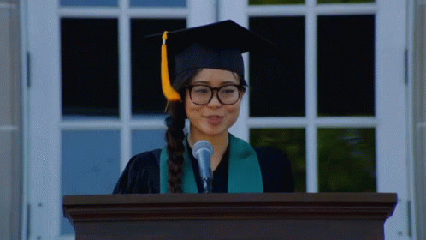
valedictorian

Slide 33
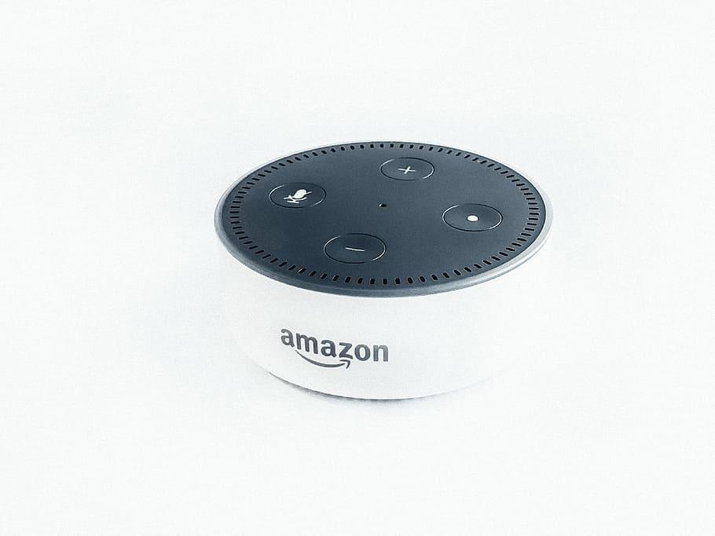
dictate
“Hey Alexa,
add milk to my shopping list.”

Slide 34
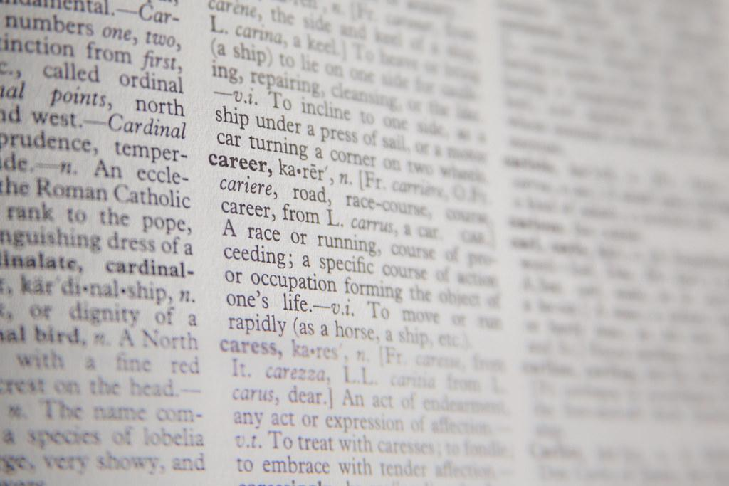
dictionary

Slide 35
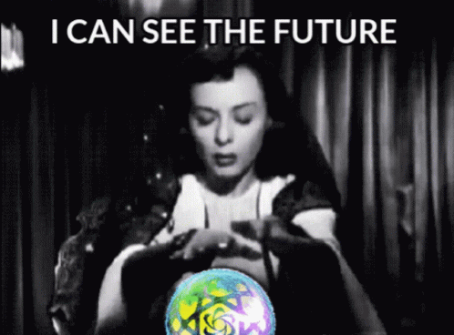
prediction

Slide 36
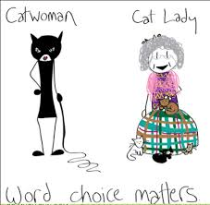
diction

Slide 37
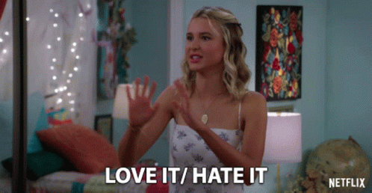
contradict

Slide 38
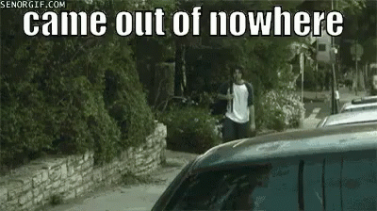
unpredictable

Slide 39
HOMOPHONE PAIR Review!
The amount of snowfall will ____________ by region.
She is ______________ tall.
You run ______________ fast.
I try to ______________ which fruits and vegetables I eat.
vary
very
very
vary

Slide 40
Day
6

Slide 41
Spelling Practice Quiz
dictionary
valedictorian
dictate
unpredictable
prediction
contradict
diction

Slide 42
HOMOPHONE PAIR!
I vary the types of books I read.
2. It was very kind of you to check on me.

Slide 43
Day
7

Slide 44
Spelling Practice Quiz
dictate
prediction
unpredictable
contradict
dictionary
diction
valedictorian

