Slide 1

2nd grade: Week 23
Notes:
Note that this is a 4-day week.

Slide 2
Day
1

Slide 3
GRAMMAR GOAL FOR THE WEEK:
Find and correctly write possessives.

Slide 4
Grammar Time:
This is his book.

Slide 5
Grammar Time:
This is Jaden’s book.

Slide 6
Grammar Time:
This is _______’s book.

Slide 7
Grammar Time:
I like her raincoat.

Slide 8
Grammar Time:
I like Tanisha’s raincoat.

Slide 9
Grammar Time:
I like my sister’s raincoat.

Slide 10
Grammar Time:
I like ______’s raincoat.

Slide 11
What do you notice about this list of words?
worry | backward | worse | world
dollar | favor | sugar | grammar
color | doctor

Slide 12


Slide 13
ar | or
backward dollar sugar grammar | worry worse world color doctor favor

Slide 14
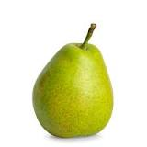
HOMOPHONE PAIR!
hear
here

Slide 15
Day
2

Slide 16
Grammar Time:
Practice finding possessives!

Slide 17
HOMOPHONE PAIR!
Please put your paper right _________.
I can’t _______ you. Please speak up.

Slide 19
ar | or

Slide 20
Day
3

Slide 21
Grammar Time:
hear
I can’t here you. Please speak louder.
The lizard ate all its food.
There is no weigh that I can live here anymore.
The dear had enormous antlers.
There is a not in my shoelaces that I can’t untie.
The baby through all her toys on the floor.
way
deer
knot
threw

Slide 22
Grammar Time:
I need to close the refrigerator door or else it can damage the food.
I am not aloud to walk to the library alone because I am only eight.
I wood like to go on a trip to Japan.
The cold wind blew down all the leaves.
I cot a firefly and put it in a jar.
I won a metal in the 100 yard dash.
allowed
would
caught
medal

Slide 24
spider

Slide 25
cheddar

Slide 26
rumor

Slide 27
tractor

Slide 28
harbor

Slide 29
solar

Slide 30
liar

Slide 31
stranger

Slide 32
rather

Slide 33
proper

Slide 34
horror

Slide 35
razor

Slide 36
splendor

Slide 37
cedar

Slide 38
lunar

Slide 39
molar

Slide 40
Day
4

Slide 41
Grammar Time:
That is Jess soccer ball.
I went to my friend house.

Slide 42
HOMOPHONE PAIR!
Write a sentence that has here and hear used correctly in it.

Slide 43
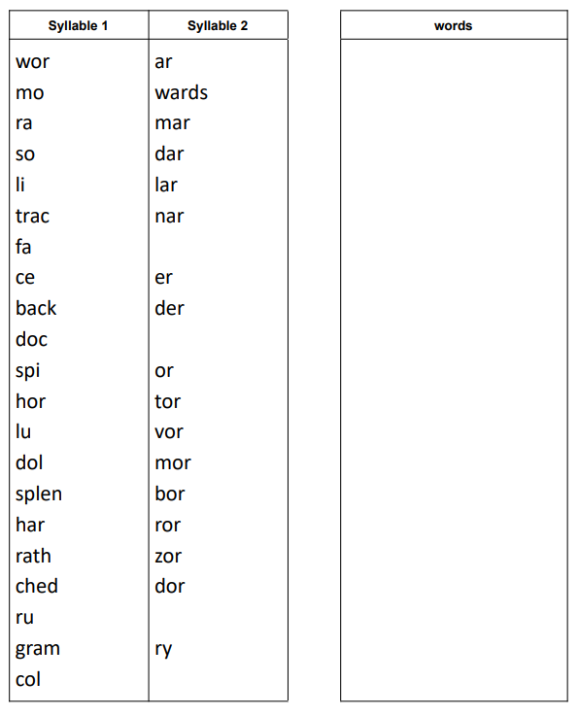

Slide 44
Day
5

