Slide 1
Content Session 4: EXPLORING ALGEBRAIC THINKING
New Teacher Orientation:
Middle School Math 2017

Slide 2
Term | 1 | 2 | 3 | 4
Fraction | $$\frac{1}{2}$$ | $$\frac{2}{3}$$ | $$\frac{3}{4}$$ | $$\frac{4}{5}$$
If the list of fractions above continues in the same pattern, which term will be equal to 0.95?

Slide 3
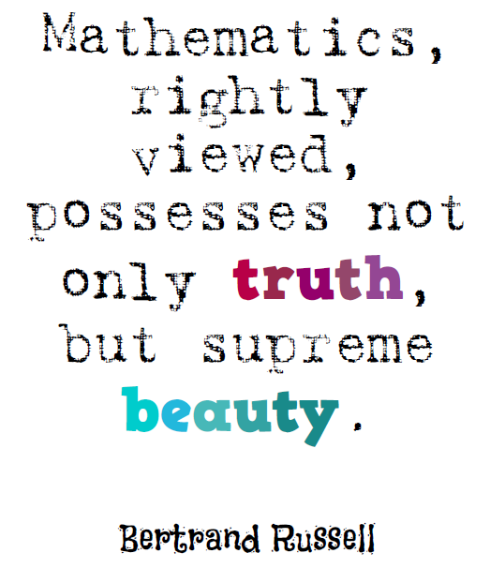

Slide 4
Mini-Assignment:
Connect this problem to a math practice.

Slide 5
MP 8: Look for and express regularity in repeated reasoning.

Slide 6
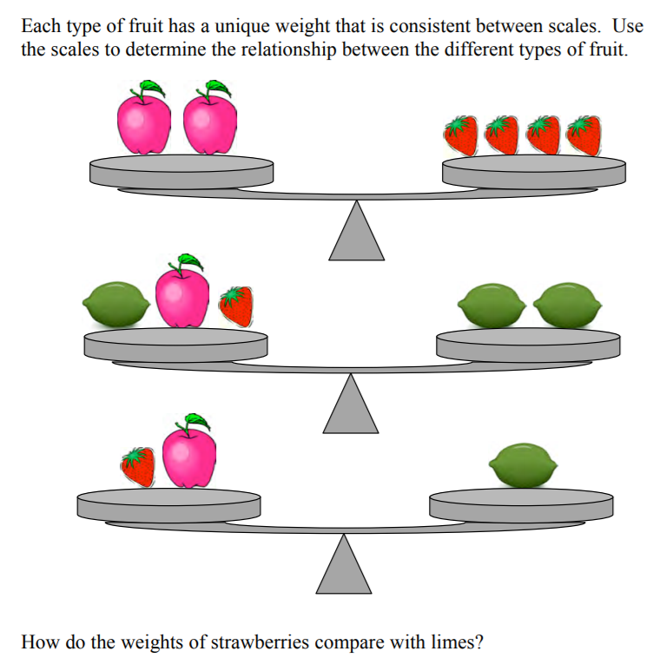

Slide 7
Mini-Assignment:
Connect this problem to a math practice.

Slide 8
MP 7: Look for and make use of structure.

Slide 9
Assignment 1 : KNOW YOUR STANDARDS.
Summarize the EE standards in grades 6 and in the 7th grade accelerated standards (including the 8th grade ones). Make sure EVERYONE in your group understands each standard.
Then match the given problems to a standard.

Slide 10
PSAT question
A babysitter earns $8 an hour for babysitting 2 children and an additional $3 tip when both children are put to bed on time. If the babysitter gets the children to bed on time, what expression could be used to determine how much the babysitter earned?
8 +3x , where x is the number of hours
3 +8x , where x is the number of hours
x(8 + 2) + 3, where x is the number of children
3 + (8 + 2)x , where x is the number of children

Slide 11
ALGEBRA EVERYWHERE

Slide 12
“If students are to be successful in algebra, which is more abstract and symbolic, such discussions must be a part of the daily middle school mathematical experience… [this] requires planning in advance – deciding what questions you can ask to help students think about generalized characteristics within the program they are working on across the mathematical strands (not just when they are in an “algebra” unit).” – Van de Walle et al, 224.

Slide 13
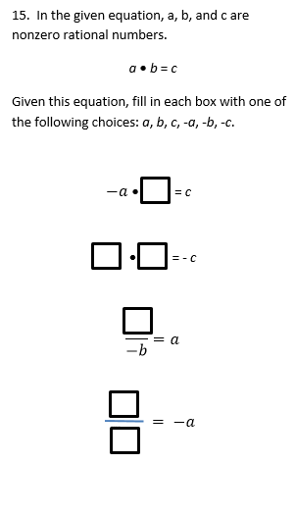

Slide 14
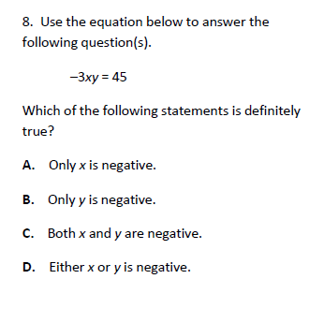

Slide 15
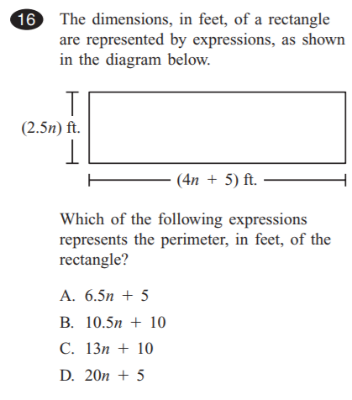
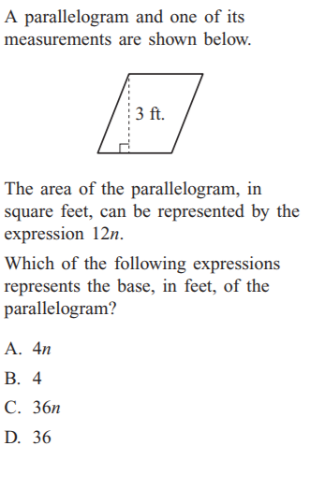

Slide 16
ASSIGNMENT 2:
Find a standard you are teaching and consider how you could incorporate the generalized thinking of algebra and incorporate it into those standards.

Slide 17
5th grade problem in Singapore
Mrs. Chen made some tarts. She sold 3/5 of them in the morning and ¼ of the remainder on the afternoon. If she sold 200 more tarts in the morning than in the afternoon, how many tarts did she make?

